Slide 1
How annual members and casual riders differ
Presented BY: Carmelo Pannetto
Last updated: 01/11/2021

Slide 2
Table of Contents
Objective
Analysis of trips data
Recap on discoveries
Conclusion
Appendix

Slide 3
Objective
Find any trends to help converting casual riders into annual members taking in account :
Length of trips measured in minutes
Counts of trips made
Weekdays and months when trips happened

Slide 4
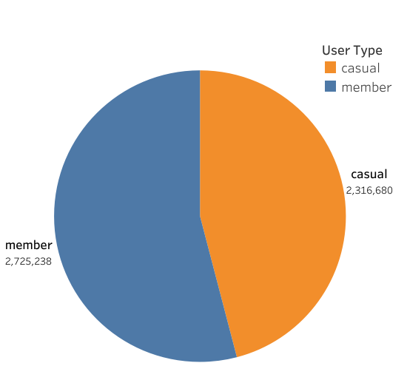
Data Overview:
Number of rides made by Users
Our dataset contain trips from the last 12 months: October 2020 to September 2021.
Contains trips from 692 station across Chicago.
Data is limited due to privacy restriction on personals user’s information.
46%
54%

Slide 5
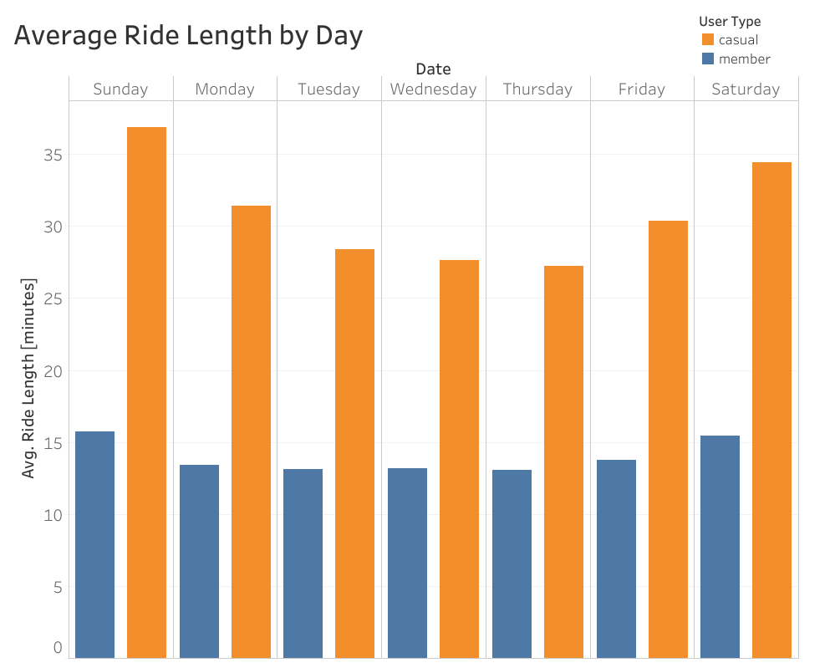
Users driving style during weekdays
Key takeaways:
Members maintain a steady trips duration for almost all days, with a slightly increase during week-ends.
Casual users have doubled members trip’s duration during all week, with peaks on week-ends.

Slide 6
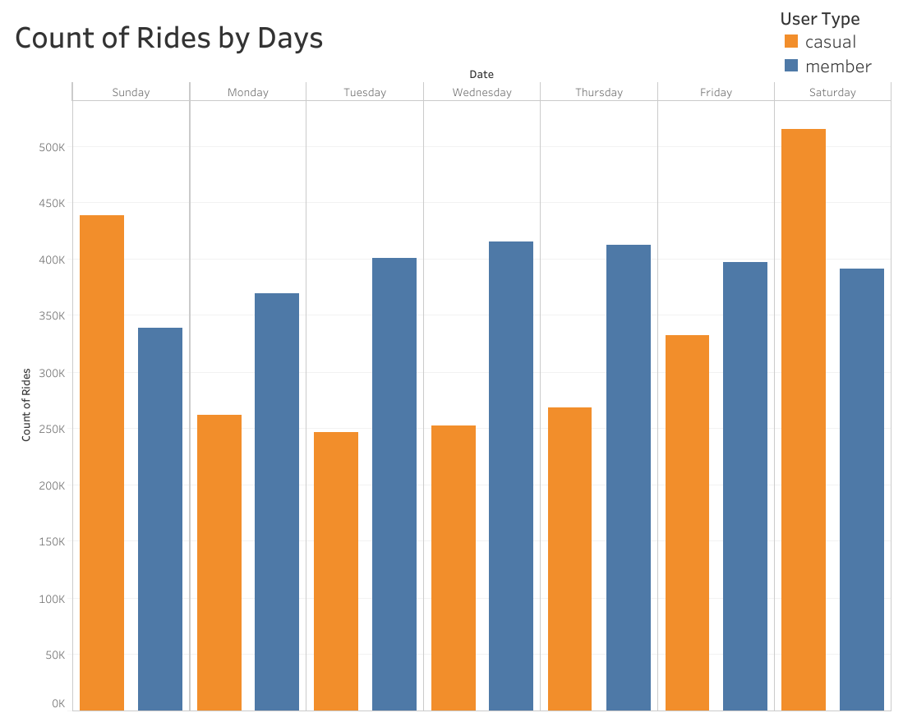
Users driving style during weekdays
Key takeaways:
Members tend to have a steady number of trips during the week, with a tiny drop on Sunday and Monday.
Casual user tend instead to use the bike more on week-ends, and they overcome members only in 2 days , Saturday and Sunday .
The difference is likely a product of a Monday to Friday work-week.

Slide 7
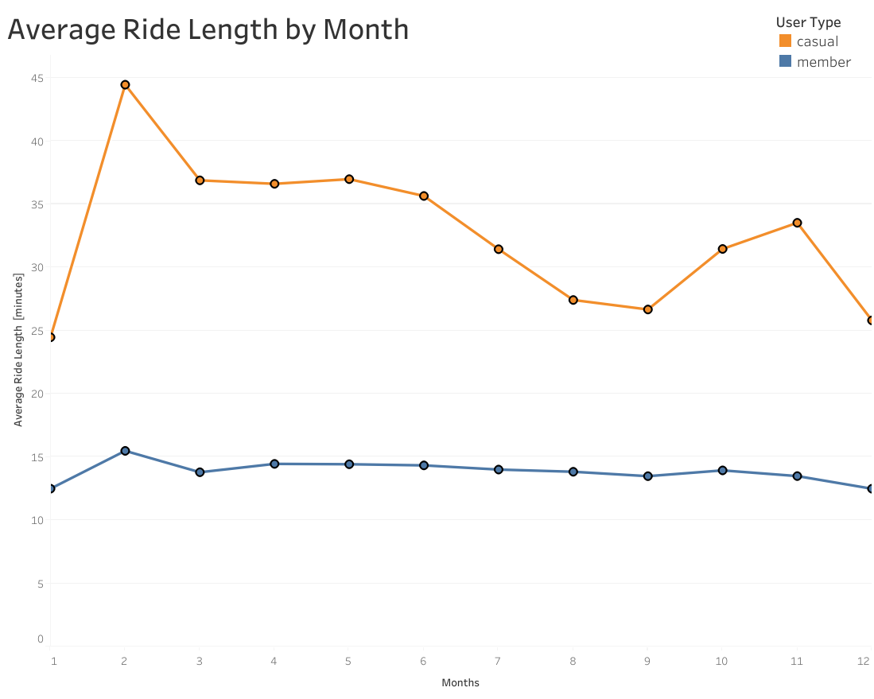
Users driving style during months
Key takeaways:
Members tend to have the same trips duration during the whole year, with a tiny increment on February.
Casual users, have a peak on February , steady use till May and a decreasing length duration till September. This is probably a cause for summer hot temperature.
February
May
September

Slide 8
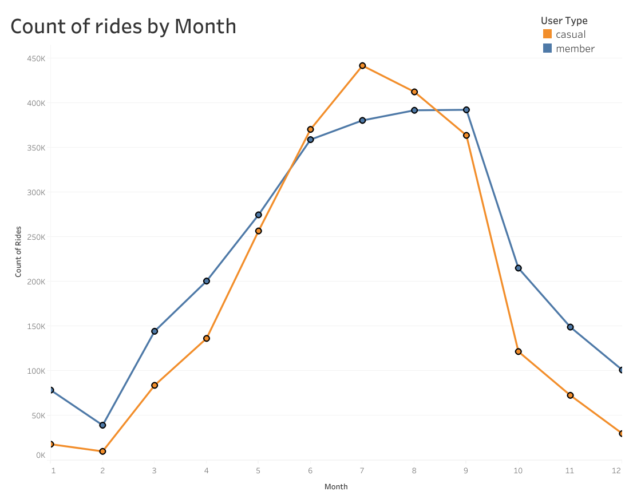
Users driving style during months
July
September
Key takeaways:
Both Members and Casual users starts riding more from February to July (with a peak from Casual users)
Both Members and Casual users starts riding substantially less from September to December
The increase of ride’s number after February, is likely due to the increase of the temperature during the year, vice-versa in September.
June
December
February

Slide 9
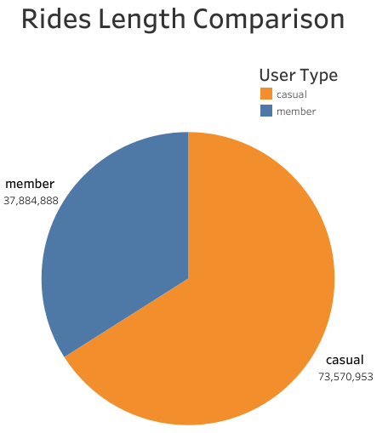
Total length made by users
Key takeaways:
Even though 54% of rides are made by members they account only for the 34% of the total length of all trips made by users.
Casual users have almost doubled members on time spent on riding bikes.
34%
66%

Slide 10
Recap on discoveries

Slide 11
Discovery’s recap:
Members
Casual
Tends to have almost the same amount of trips and the same duration during the weekdays.
Higher number of trips across warmer moths.
They spent on bike the double time of members.
There’s a usage peak on week-ends and during summer.
Even thought they represents the 46% of total trips, they account for 66% of bikes usage.

Slide 12
Conclusion

Slide 13
Advice to converting Casual users
Week-ends and summer are the periods which Casual users do most of the trips that’s why a target advertising is important:
Focused advertise campaign during May(pre-summer), and getting ready for a high usage from both users.
Focused advertise on certain day , like Thursday/Friday to let Casual users know of the advantage of a membership on the day before they usually starts to ride more.
Press on the sustainability of a Cyclystic’s scheme, where Cycling contribute to low emission, better air quality and better health.

Slide 14
Appendix
More about data

Slide 15
More about data analysis:
Data is take from Motivate International Inc. under this license.
More new data will be available with passing months.
Data-privacy restriction: prohibit from using rider’s personally identifiable information, that means we’re unable to associate credit card to user and so determine if casual users lives in the Cyclistic service area, or if they have purchased multiple single passes.
If needed, we can take in account older months of data, and more aspect of bikes usage like which stations are the most used , what kind of bike is preferred etc.

Slide 16
Thank you

